Slide 1
Lab Lecture 3 – Digital Holography: Reconstruction of Real Holograms
30/10/2026

Slide 2
Lab Lecture 3: contents
Numerical reconstruction of holograms recorded by a camera
Recap: analog hologram and the three reconstructed terms (Lecture 2)
Digital holography: the camera replaces the plate, the computer replaces the reconstruction beam
In-line (Gabor) digital holograms: numerical focusing, twin image
Off-axis digital holograms: Fourier filtering, amplitude AND phase
Numerical refocusing of a microscopy hologram
References
Kostuk – Holography Principles and Applications, Ch. 3.5 (hologram geometries) and Ch. 7 (Digital Holography)
Voelz – Computational Fourier Optics a Matlab Tutorial
PyHoloscope (test data): https://github.com/MikeHughesKent/PyHoloscope
My Github Repo : https://github.com/asta-me/Analog-and-Digital-Holography-Course.git

Slide 3
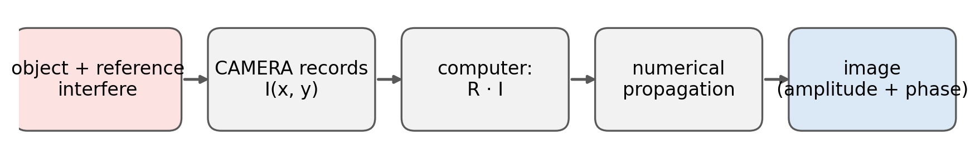
Recap: the hologram and its three terms
Recording (Lecture 2): the plate records the intensity
0 order:
weakly modulated part of the field.
Real image:
complex conjugate of the object field.
Reconstruction: illuminate the developed hologram with R
Virtual image:
our complex object field O!
In Lecture 2 everything was simulated: O, R and the propagation.
Today the hologram is a REAL camera image. We do not know O, we only have I(x, y) sampled on the camera pixels.
The reconstruction beam and the propagation are replaced by the computer: this is Digital Holography.

Slide 4
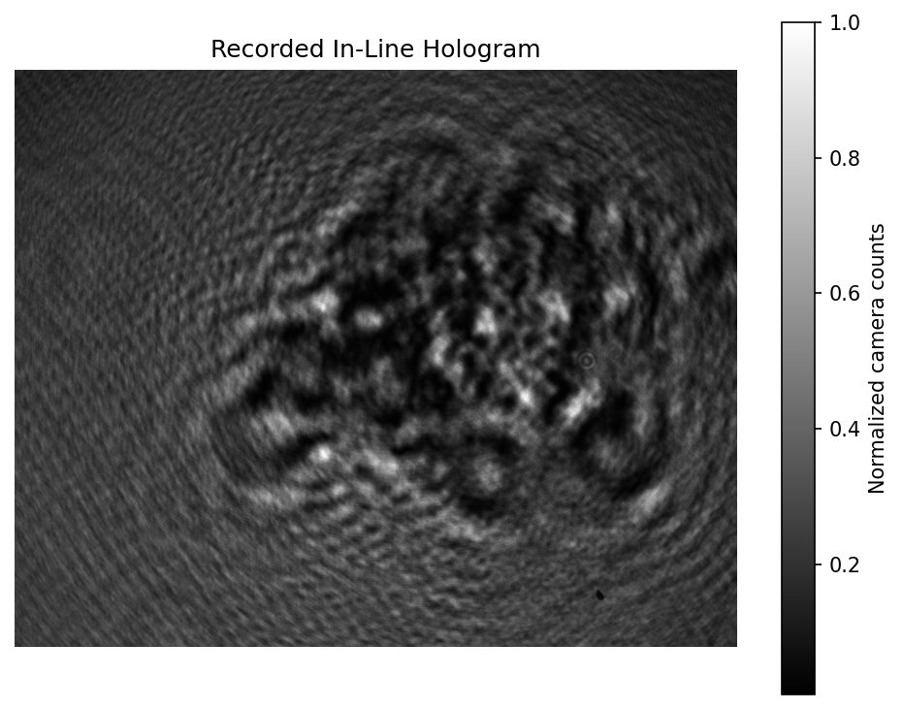
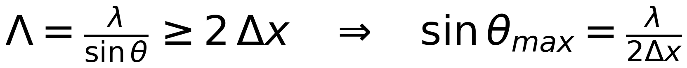
Digital Holography: what changes with a camera
The plate becomes a pixel array: Δx ≈ 1–5 µm, N ≈ 1000–4000 pixels
The reconstruction becomes the TF propagator of Lecture 1, same sampling at every z (Kostuk 7.5.2, convolution method).
We get a COMPLEX field: intensity and phase of the object.
The focus is chosen AFTER the acquisition.
Sampling constraint (Kostuk 7.3):
the interference fringes must be sampled by at least 2 pixels
θ = angle between object and reference rays.
Δx = 1 µm, λ = 630 nm → θmax ≈ 18°. Δx = 5 µm → θmax ≈ 3.6°
In-line hologram recorded by a camera: 1024 × 1280 px, Δx = 1 µm, λ = 630 nm
Data: PyHoloscope test set (MIT), M. Hughes, Applied Optics Group, Univ. of Kent

Slide 5
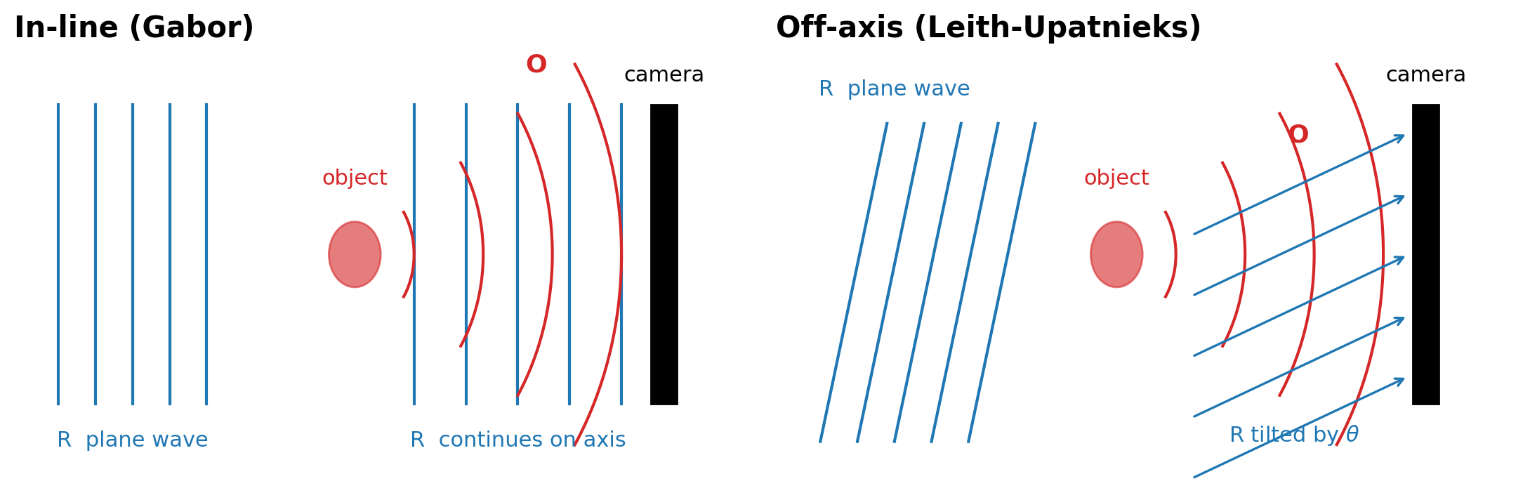
Two recording geometries
In-line (Kostuk 3.5.1, 7.4):
R is the un-scattered part of the illumination.
O and R travel along the same axis: all the terms of |O+R|² overlap in space and in frequency.
No way to separate them → reconstruct by numerical focusing, live with the twin image.
Off-axis (Kostuk 3.5.2, 7.4):
R is a separate plane wave tilted by θ.
The tilt puts O·R* and O*·R on two different carrier frequencies ± sinθ/λ.
The terms can be separated in the Fourier domain → clean complex field O.

Slide 6
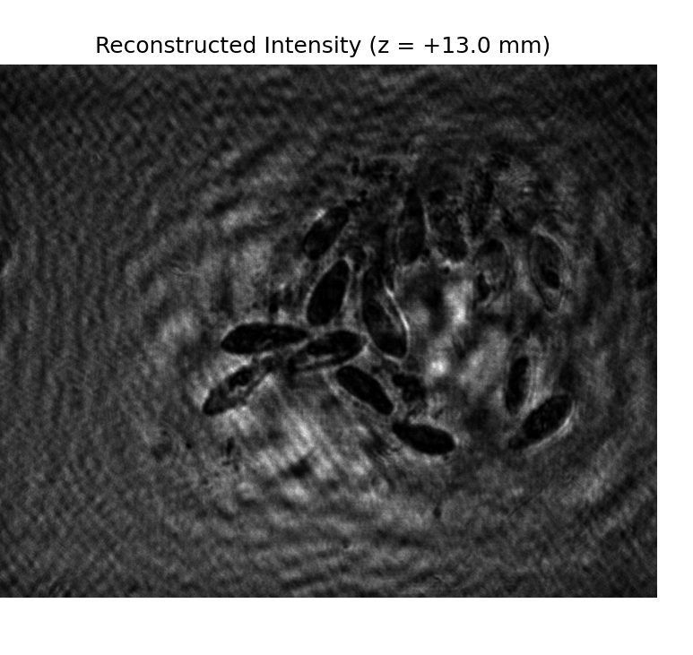
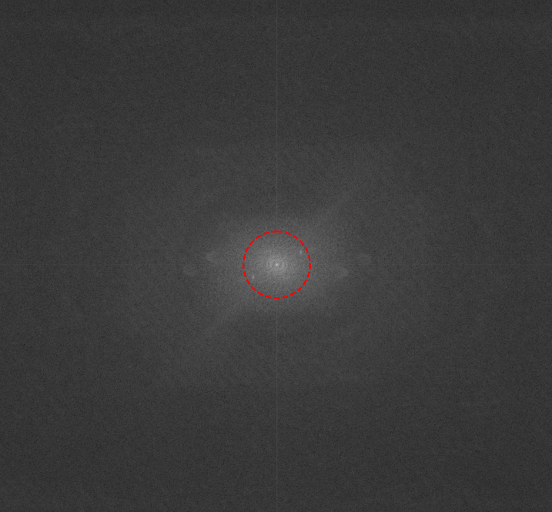
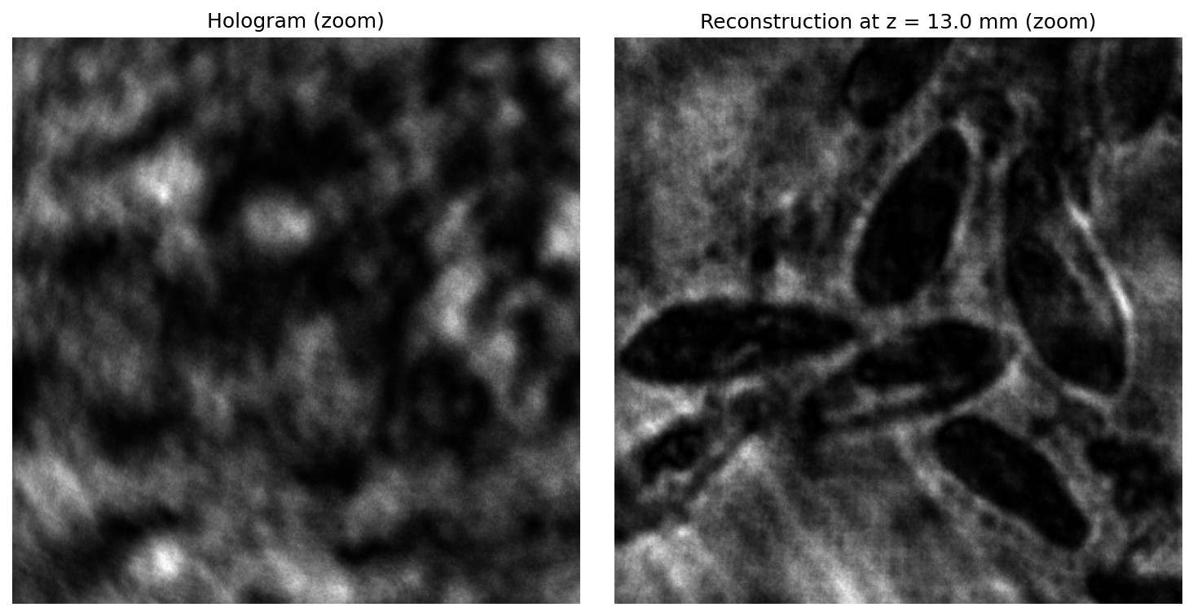
In-line DH: reconstruction by numerical focusing
Illuminate with R = 1 and propagate (TF method):
At z = +z₀ one image is sharp, the twin image is a defocused halo.
I(x,y) is real and R = 1 → u(−z) = u(+z)*: same intensity at ±z, opposite phase. Real and virtual image cannot be told apart.
Spectrum: one central lobe, nothing to isolate
Reconstructed intensity at z₀ = 13 mm
Dashed: band where the TF kernel H is correctly sampled at z₀ = 13 mm (Lecture 1 limit z ≤ NΔx²/λ, extended to the band actually used).
Zoom: hologram fringes (left) → focused objects with twin-image ringing (right)

Slide 7
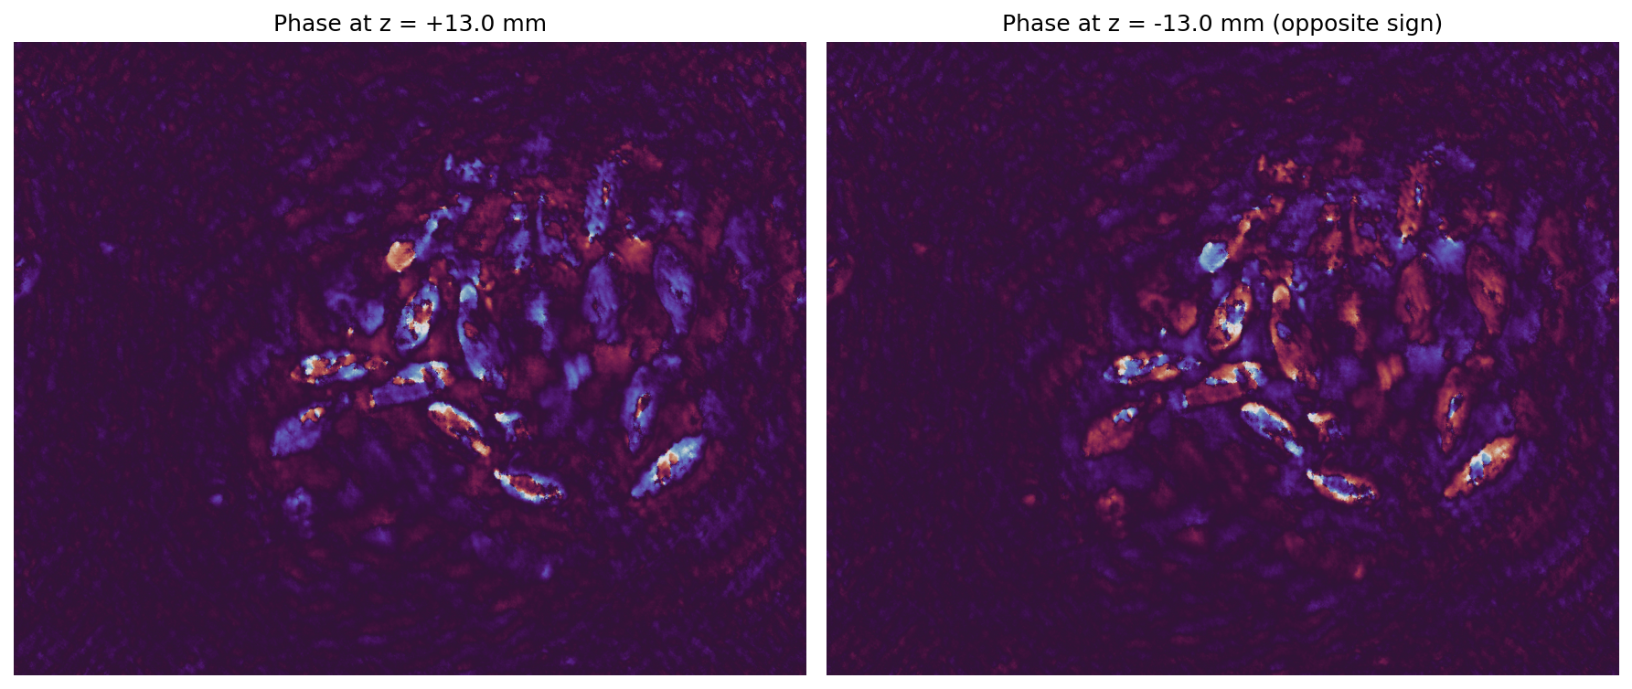
In-line DH: phase and focus scan
The phase IS reconstructed (the field is complex), but the overlapping 0 order and twin image make it useless quantitatively.
Zero-order suppression (Kostuk 7.6.1): subtract the mean, or a background hologram taken without the object. Does not remove the twin image.
Phase of the reconstructed field at +z₀ (left) and −z₀ (right): opposite sign, corrupted by zero order and twin image
Focus scan: save a z-stack for ImageJ (as in Lectures 1 and 2)
depths = np.linspace(0, z_focus + delta_z, 41) → DH_inline_intensity_stack.tif, DH_inline_phase_stack.tif
Scroll the stack: particles come into focus one by one, each with its own halo. Negative z gives the same intensities.
Script: Lec_3/DH_inline_reconstruction.py

Slide 8
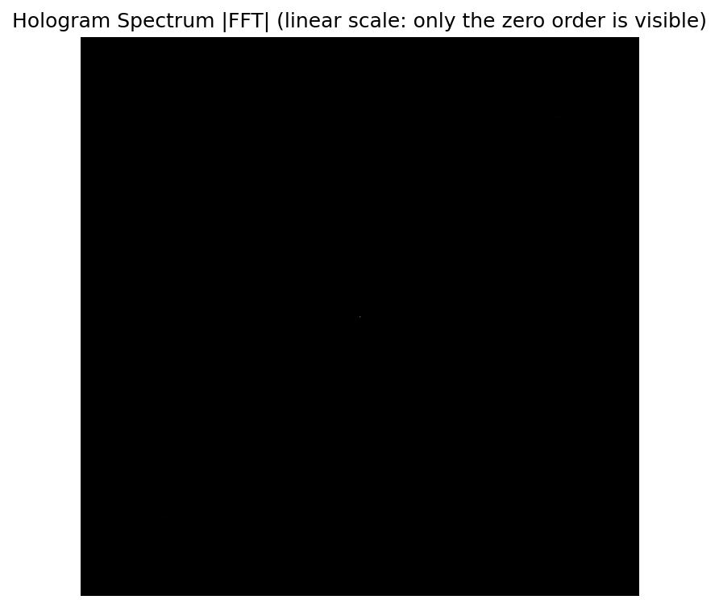
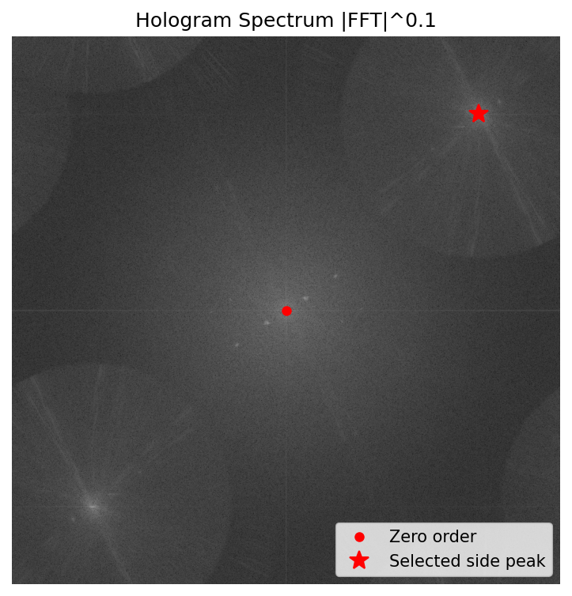
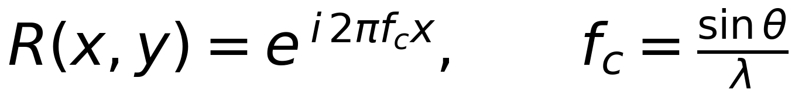
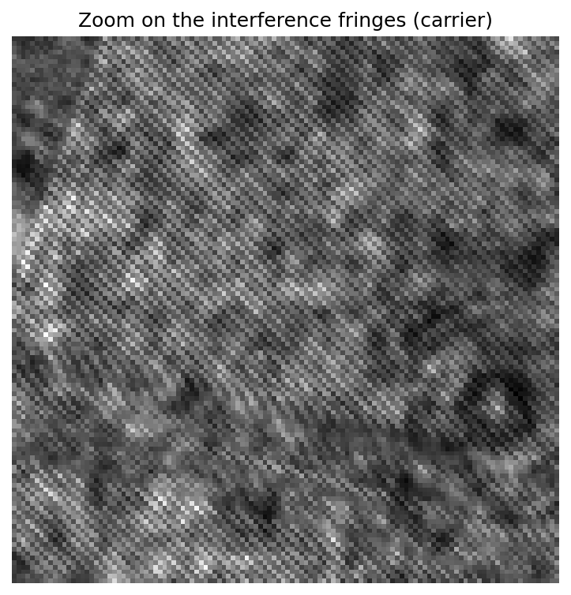
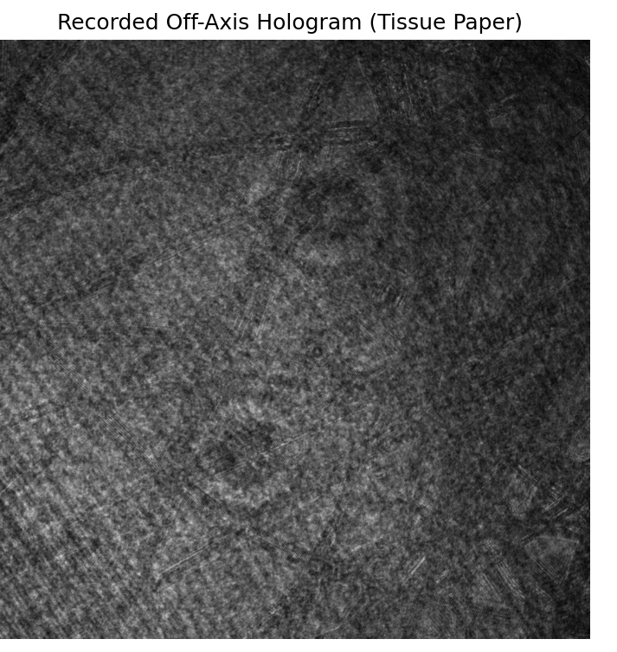
Off-axis DH: a carrier frequency separates the terms
Tilted plane-wave reference (Kostuk Eq. 7.6):
In the Fourier domain: |O|²+|R|² stays at the centre (0 order), O is shifted to −f_c, O* to +f_c.
Separation condition: f_c > 3B/2 where B is the object bandwidth (|O|² has bandwidth 2B).
Sampling: f_c + B < 1/(2Δx) → fringe period ≥ 2 pixels.
|FFT| linear: only the 0 order
|FFT|^0.1: 0 order + two side peaks
Red star: the side peak we keep, at (row, col) = (145, 872).
Its distance from the centre is the carrier frequency: 1670 cycles/mm → θ ≈ asin(λ f_c) in the sample plane.
The other peak is the twin O*: point-symmetric copy, same information.
Tissue paper, Δx = 0.3 µm (after magnification), λ = 630 nm
fringes, 2 px period
hologram
Data: PyHoloscope test set (MIT), M. Hughes, Applied Optics Group, Univ. of Kent

Slide 9
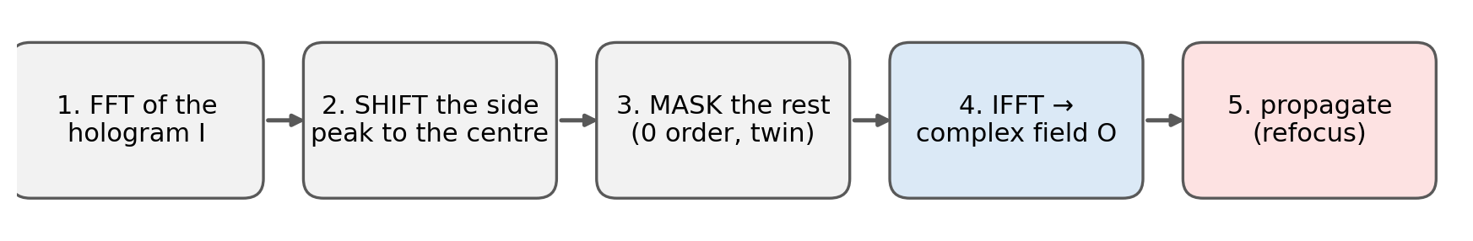
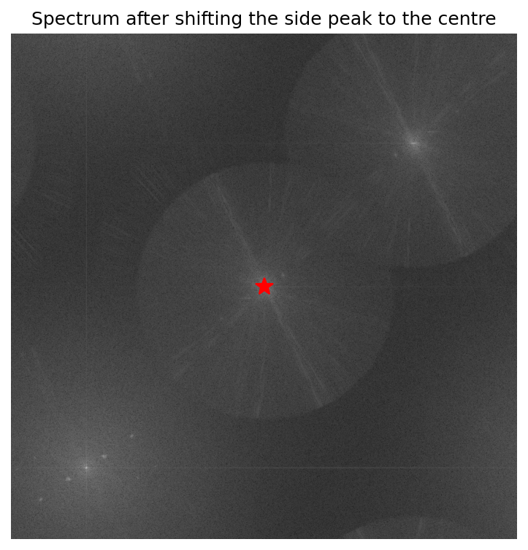
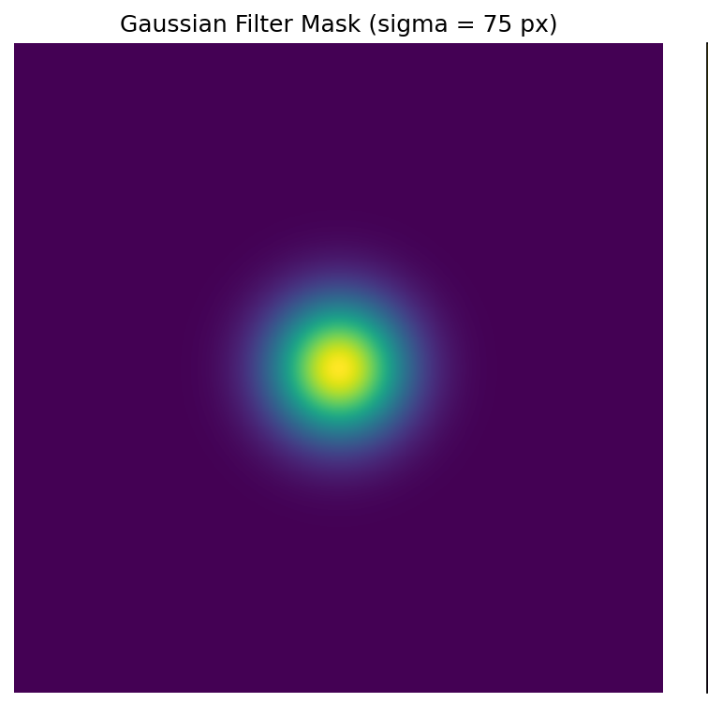
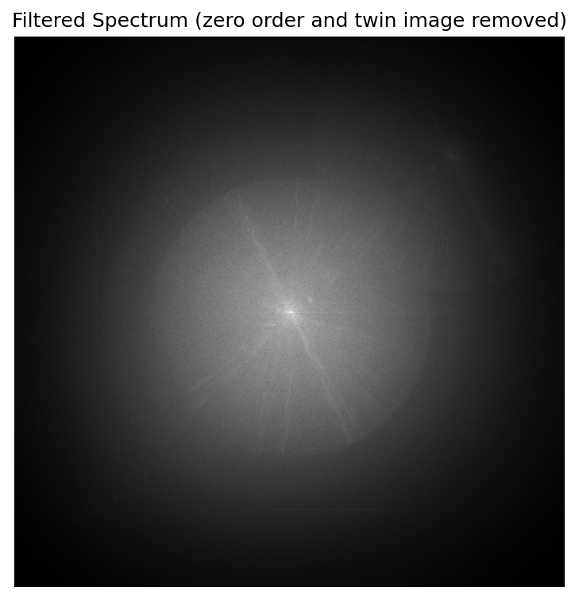
Off-axis DH: the Fourier filtering recipe
1. spectrum, select the peak
2. np.roll: peak to the centre
3. Gaussian mask, σ = 75 px
filtered spectrum: only O
Shifting the spectrum by −f_c is the same as multiplying I by R*: I·R* = … + O·|R|² + … (demodulation, Lecture 2 reconstruction with the conjugate beam).
A soft (Gaussian) mask avoids the ringing of a hard circular window. σ sets the resolution/noise trade-off.

Slide 10
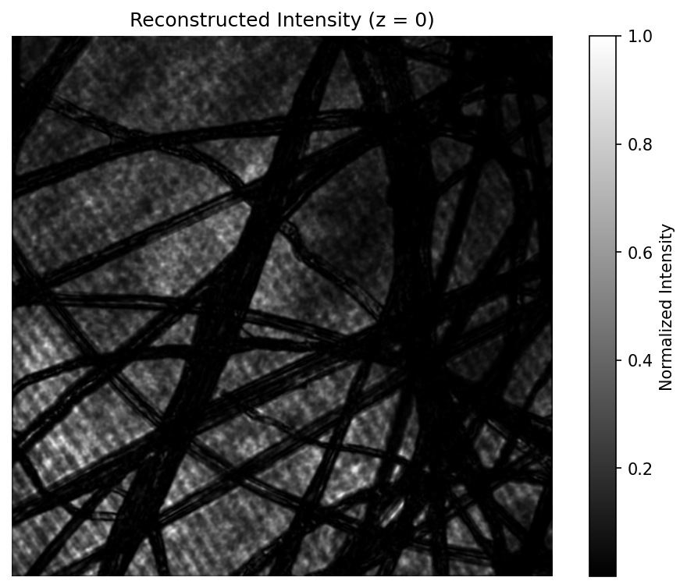
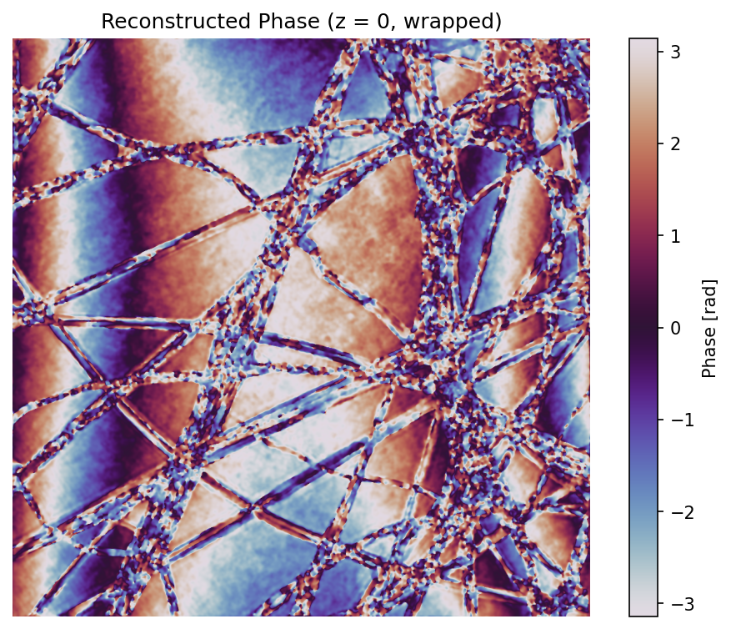
Off-axis DH: amplitude AND phase at the camera plane
Intensity |O|²: the tissue fibres, no zero order, no twin image, no fringes.
Phase arg(O): wrapped in (−π, π], proportional to the optical thickness of the sample → quantitative phase imaging.
Everything is at z = 0 (camera plane). If the sample was not in focus, we propagate O (next slide).
Script: Lec_3/DH_offaxis_reconstruction.py

Slide 11
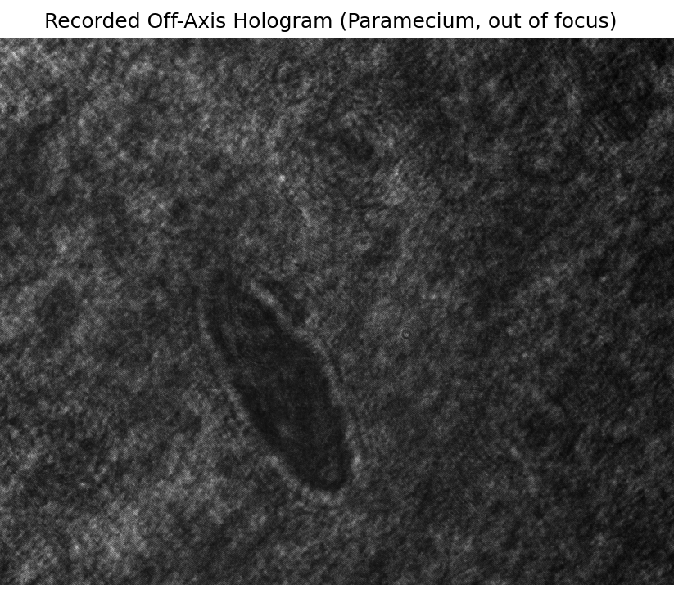
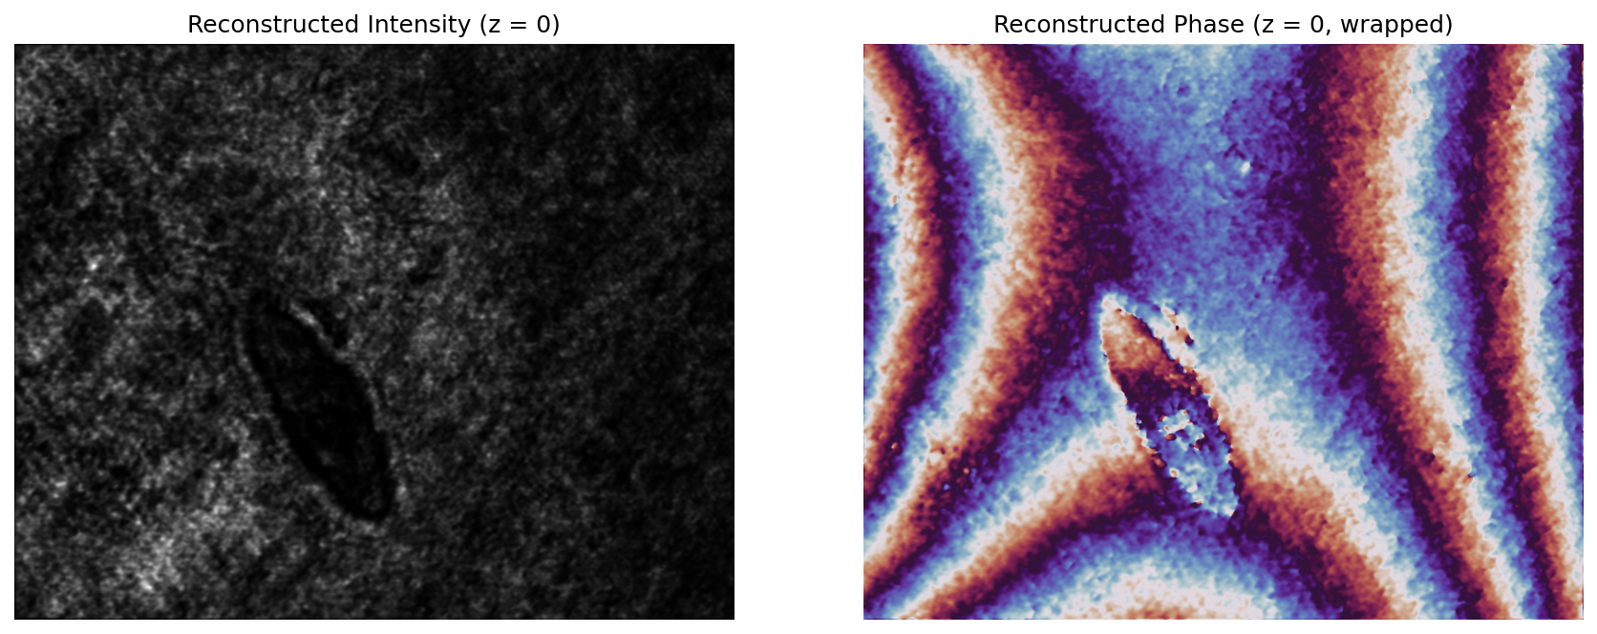
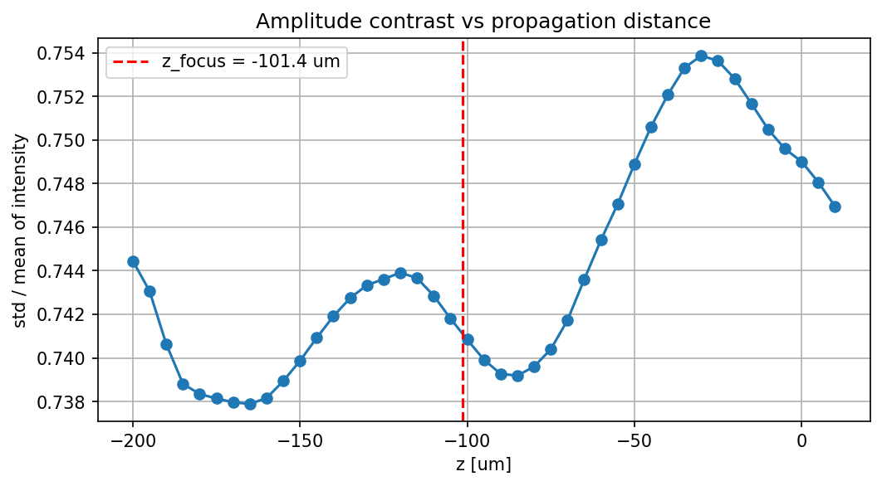
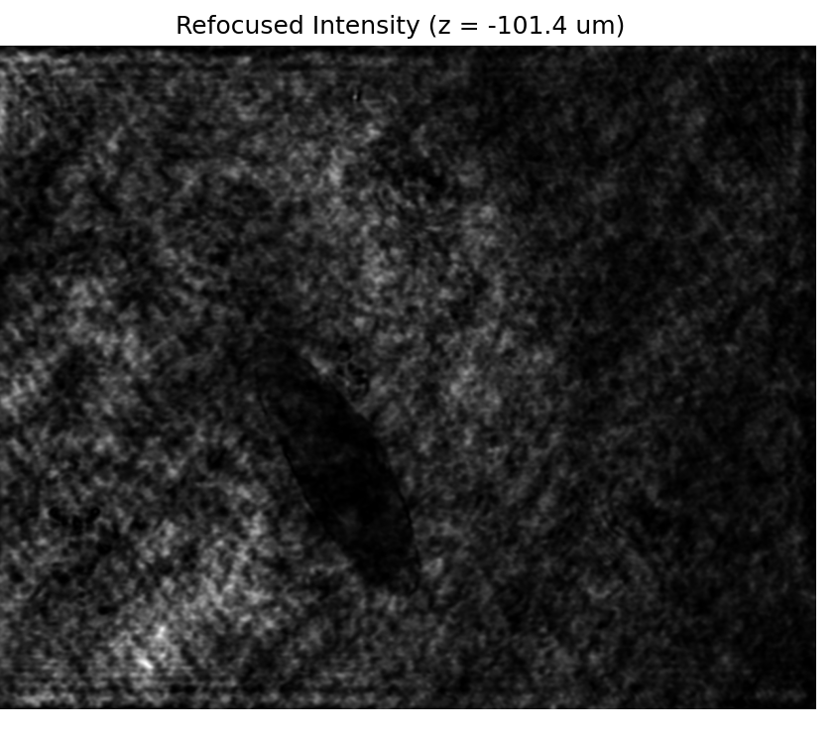
Numerical refocusing: focus after the acquisition
hologram of a paramecium, out of focus
after Fourier filtering, z = 0: intensity and phase are still blurred
Focus scan with the TF propagator (z from −200 to +10 µm).
A transparent object has almost no amplitude contrast at focus: the std/mean of the intensity has a MINIMUM at z ≈ −101 µm.
refocused intensity, z = −101 µm

Slide 12
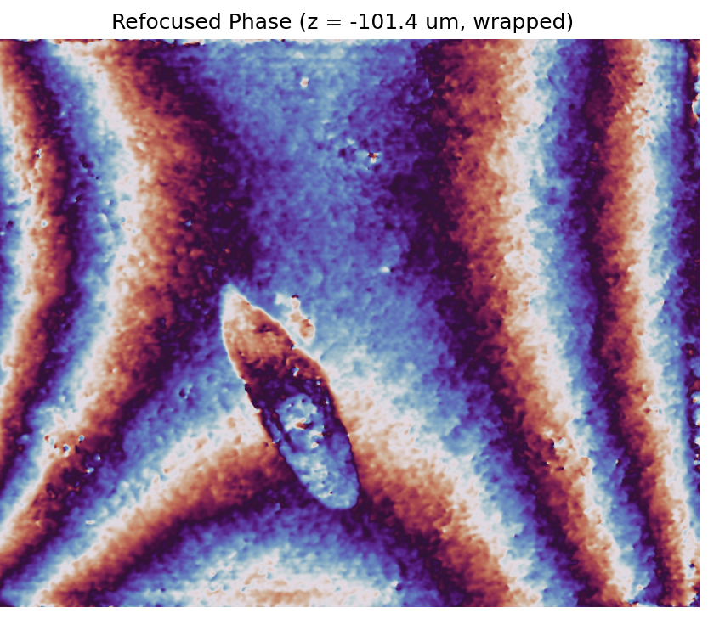
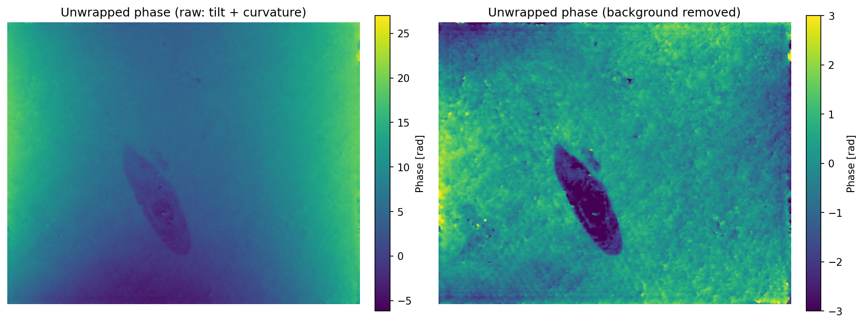
Numerical refocusing: quantitative phase
unwrapped (skimage.restoration.unwrap_phase); right: 2nd-order background (tilt + curvature) removed
refocused phase, wrapped (−π, π]
Unwrapping removes the 2π jumps and gives a continuous optical path map φ = 2π (n − n₀) t / λ.
Residual tilt: the side peak never sits exactly on a pixel → a linear phase remains; the curvature comes from a non-planar reference.
Both are fitted and subtracted (or removed with a background hologram, Kostuk 7.6).
Script: Lec_3/DH_offaxis_refocusing.py

Slide 13
In the lab: interactive off-axis reconstruction
Lec_3/DH_offaxis_interactive.py (run from a terminal, needs an interactive window)
1. Set λ and the camera pixel size Δx (divide by the magnification of your imaging system).
2. Load the BMP saved by the camera software.
3. Click two corners to select the region of interest.
4. Click on ONE side peak of the spectrum.
5. Type the Gaussian filter width σ (start with ~50 px).
6. Type the z range: intensity and phase are shown plane by plane.
Checks before clicking:
fringes visible and ≥ 2 px wide? side peaks well separated from the 0 order? region of interest without saturation?
What can go wrong
No side peaks: reference and object not interfering (coherence, polarisation, angle too large → fringes under-sampled).
Peaks too close to the 0 order: increase the reference angle; otherwise use a smaller σ (lower resolution).
Phase full of 2π jumps: normal, unwrap it; strong tilt means the peak was not centred exactly.
Nothing comes into focus: check Δx and the z range; remember z_max = NΔx²/λ for the TF method (Lecture 1).

Slide 14
Takeaways:
Digital holography
The camera samples I = |O + R|²; the computer illuminates it with R and propagates it (TF method, Lecture 1).
The result is a complex field: intensity AND phase.
The focus is chosen numerically after the acquisition.
Fringes must be sampled by ≥ 2 pixels: sinθ ≤ λ / 2Δx.
In-line vs Off-axis
In-line: simplest setup, full camera bandwidth, but 0 order and twin image overlap the reconstruction.
Off-axis: carrier f_c = sinθ/λ separates the terms → FFT, shift, mask, IFFT gives a clean O. Costs bandwidth (≤ 1/4 of the pixels).

